Slide 1


NEXT GEN EMPLOYABILITY PROGRAM
CREATING A FUTURE-READY WORKFORCE
Student Name :
K. SUHANI
Student ID :
College Name :
STU642195215bc101679922465
SR UNIVERISTY

Slide 2
CAPSTONE PROJECT SHOWCASE
Project Title
NEWS AGGREGATOR USING DJANGO FRAMEWORK
Abstract | Problem Statement | Project Overview | Proposed Solution | Technology Used | Modelling & Results | Conclusion | Q&A

Slide 3
Abstract
1
This project aims to develop a web-based News Aggregator using the Django Framework, facilitating the aggregation of news articles from diverse online sources.
2
The News Aggregator will categorize news articles into different topics, provide users with a user-friendly interface for browsing and searching news content, and offer features such as user authentication, personalization, and real-time updates.
3
The project will leverage Django, a high-level Python web framework, for backend development, HTML and CSS for frontend design, and various Python libraries for tasks such as web scraping and data manipulation.
4
Targeting a diverse audience of news enthusiasts, professionals, and casual readers alike, our aggregator aims to empower users with the information they need to make informed decisions and stay ahead in an ever-evolving world.

Slide 4


Problem Statement
In today's digital world, we're bombarded with news from all directions, making it hard to keep up. Traditional news apps and websites often overwhelm us with too much information, and it's tough to find stories that really matter to us. Adding to the confusion, social media mixes real news with fake stories, making it hard to know what's true. Plus, these platforms tend to show us only what we already agree with, limiting our exposure to different viewpoints.What we need is a new kind of news app that understands what we're interested in and shows us the most important stories in a simple, easy-to-understand way.

Slide 5

Project Overview
The project aims to develop a user-friendly news aggregator application that provides curated news content from various reputable sources. Unlike traditional news platforms, this aggregator will utilize machine learning algorithms to personalize news recommendations based on user preferences, browsing history, and reading habits. The application will aggregate news articles from different categories such as politics, technology, sports, entertainment, and more.

Slide 6
Proposed Solution
The proposed solution is to develop a comprehensive news aggregator platform that addresses the challenges of information overload, filter bubbles, and misinformation. This platform will offer users a personalized and diverse news experience by leveraging advanced algorithms and user profiling. Users will create profiles upon registration, providing information about their interests, preferred news categories, and reading habits. Using this data, the platform will curate a personalized news feed, presenting articles tailored to each user's preferences. Additionally, the platform will prioritize diversity by including articles from various political ideologies, cultural backgrounds, and geographic regions.

Slide 7
Technology used
HTML (Hyper Text Markup Language):
HTML is the standard markup language for creating the structure of web pages. In our project, HTML is used to define the content and layout of each page, including headings, paragraphs, links, and lists. With HTML, we can create a hierarchical structure for displaying news articles and other information in a user-friendly manner.
CSS (Cascading Style Sheets):
CSS is a stylesheet language that styles the appearance of HTML elements on web pages.It allows us to enhance the presentation and user experience of our News Aggregator by defining colors, fonts, layouts, and other visual aspects.With CSS, we can create a visually appealing and responsive design that adapts to different screen sizes and devices.
Django (Python Web Framework):
Django is a powerful Python web framework that facilitates rapid development of web applications. It handles URL routing, database management, and template rendering, making it ideal for building complex web projects like our News Aggregator.
Python:
Python is a versatile and easy-to-read programming language widely used for web development. It serves as the primary language for backend development in our project, handling business logic, data processing, and interaction with external APIs.

Slide 8
Modelling & Result
The news aggregator platform is designed to offer users a personalized and engaging news browsing experience. Through sophisticated user profiling mechanisms, the platform collects and analyzes data on user preferences, interests, and reading habits. This information is leveraged to create individual user profiles, which serve as the foundation for generating personalized news feeds. By categorizing news articles into various topics and themes, such as politics, sports, technology, and entertainment, the platform ensures a diverse range of content catering to different user interests. Advanced recommendation algorithms then process user profiles and article metadata to curate personalized news feeds for each user, considering factors like relevance, recency, and diversity.

Slide 9
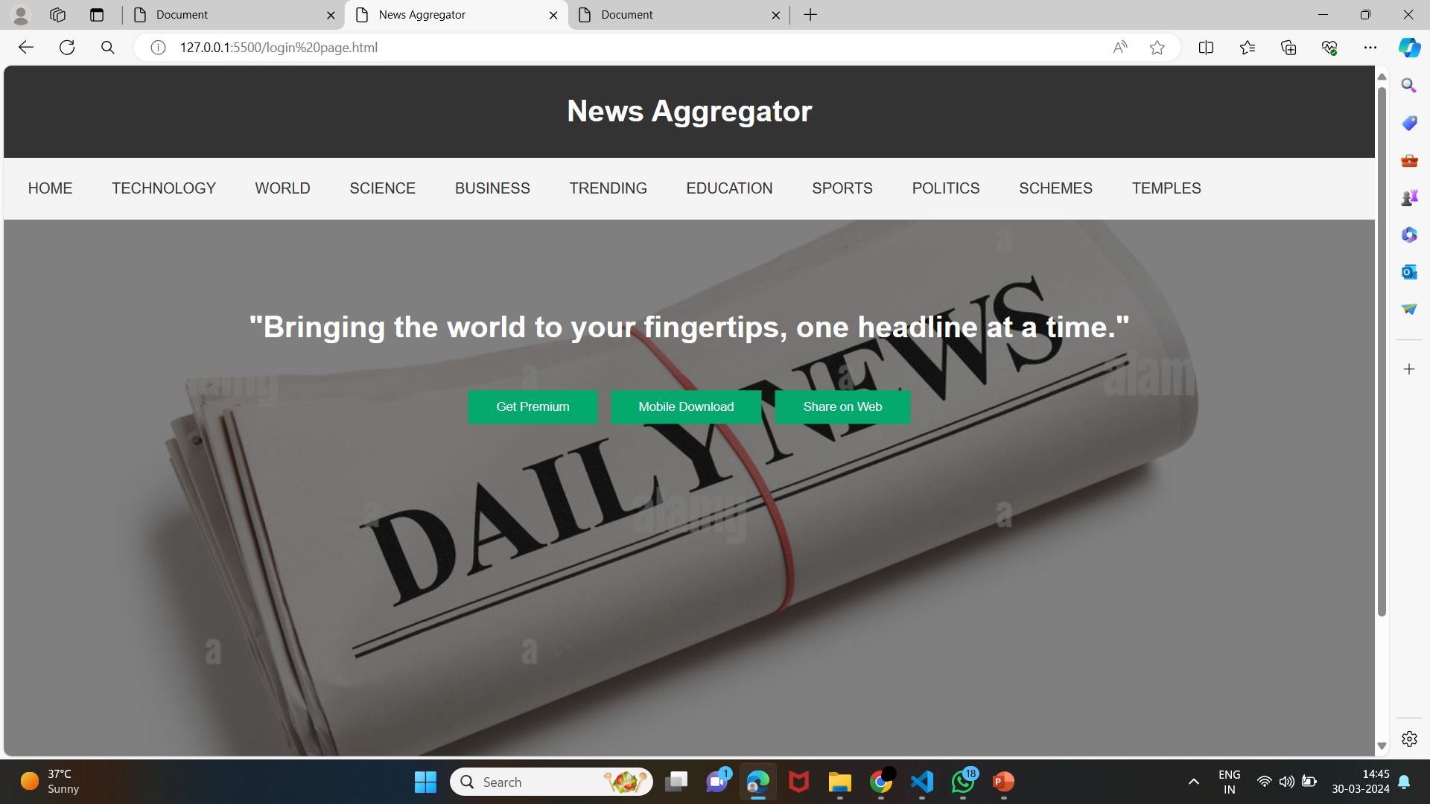
Modelling & Result

Slide 10
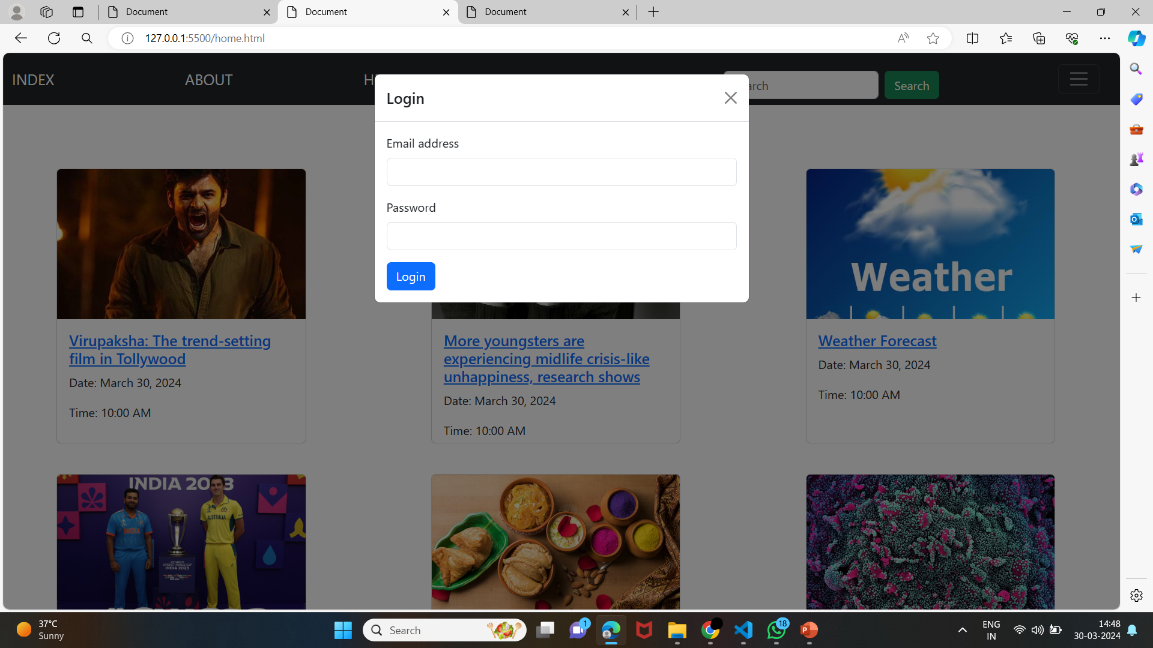
Modelling & Result

Slide 11

Conclusion
In conclusion, this news aggregator platform not only transforms how users consume news but also redefines their interaction with information. By harnessing advanced profiling and recommendation algorithms, it transcends traditional news browsing by offering a tailored experience for every user. This personalized approach not only fosters user engagement but also fosters a deeper connection with the content presented. As the platform evolves through user feedback and continuous refinement, it stands as a testament to the power of technology in shaping our digital experiences. In an age inundated with information, this platform emerges as a beacon of relevance, ensuring users stay informed, enlightened, and engaged with the world around them.

Slide 12


Notes:
Thank You !!

